Slide 1
Analysis of Promotional Effectiveness for Major Supermarket Chain
Guided by Prof. Khasha Dehnad

Slide 2
Data Understanding
The datasets contained promotional and sales data from the time period of 1st April 2018 to 30th September 2018.
Some of the attributes we will be using and their information are as follows
  UPC_SCAN_QTY : The no. of units of that item that were sold in one transaction
  TTL_SCAN_DLR_AMT: The sales of that item in dollar amount for the transaction
  UPC_CAT_CODE: The product category that the item belongs to
  DSCNT_AMT: The value of a discount coupon
  DIGITL_DSCNT_AMT: The value of a digital discount coupon
  MIXNMTCH_DSCNT_AMT: The value of a Mix n Match Coupon
  AD_ITM_PRTY_CODE: The type of Ad size that was run for the item in the weekly ad brochure

Slide 3


Data Preprocessing
We also split the dataset based on the three categories of items that were sold, namely
  Ready to Eat Cereal
  Wholesome Pantry
  Poultry
The split was performed on the basis of the upc_cat_code.
This would allow us to examine and analyze each category a bit more closely.

Slide 4
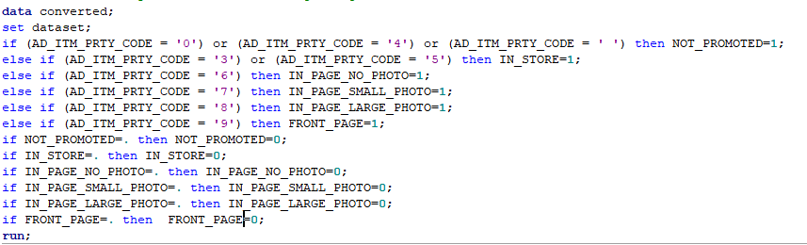
Data Preprocessing
Since the data is fragmented, we first concatenate the data in SAS to create our combined dataset.
Also since AD_ITM_PRTY_CODE is a categorical variable with non-binary values, we create dummy variables to store the value for each category

Slide 5
Exploratory Data Analysis

Slide 6
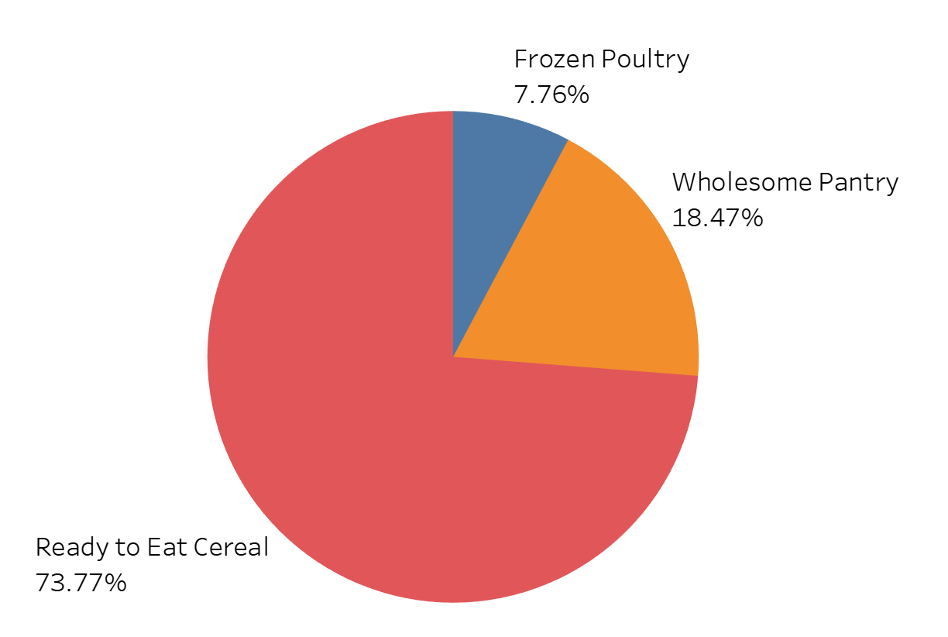
Analysis - Sales by Product Category

Slide 7
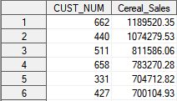
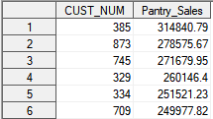
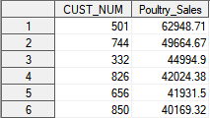
Data Analysis
For our analysis of promotional effectiveness, we decided to focus on the most successful stores in each of the 3 categories, to observe what kind of discount types and ad types proved to be the most effective in driving sales in that product category.
Optimally some of their strategies could be replicated by other stores who are lacking in those categories.
We selected the store with the highest sales in each area.
  Cereals - Store 662
  Wholesome Pantry - Store 385
  Poultry - Store 501

Slide 8
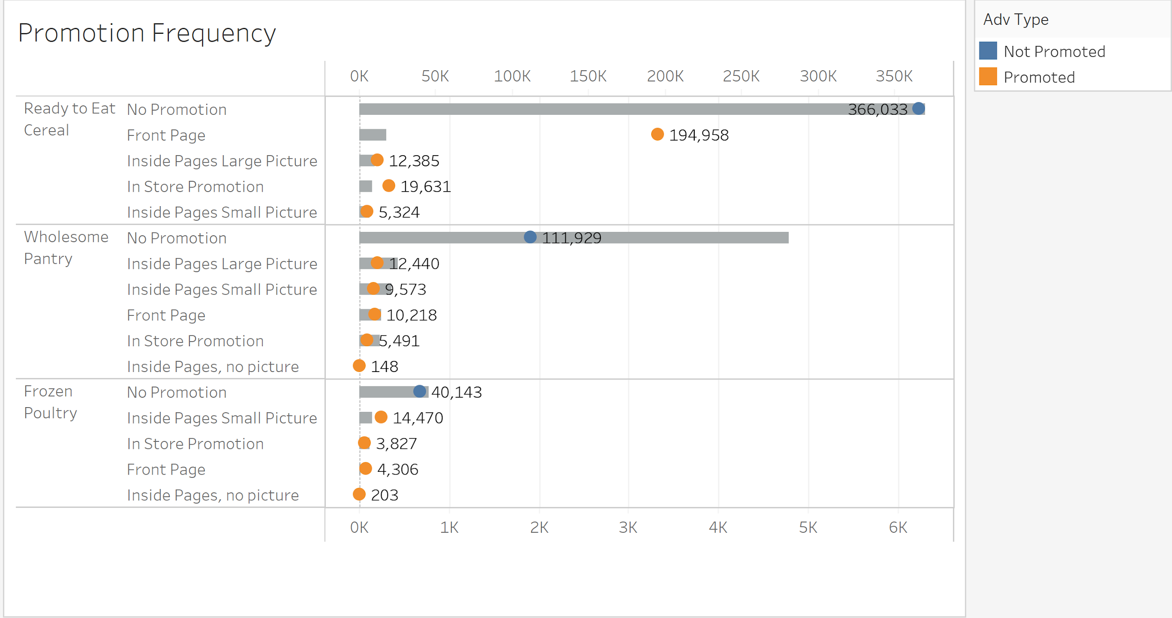
Promotion Frequency, Sales by Category

Slide 9
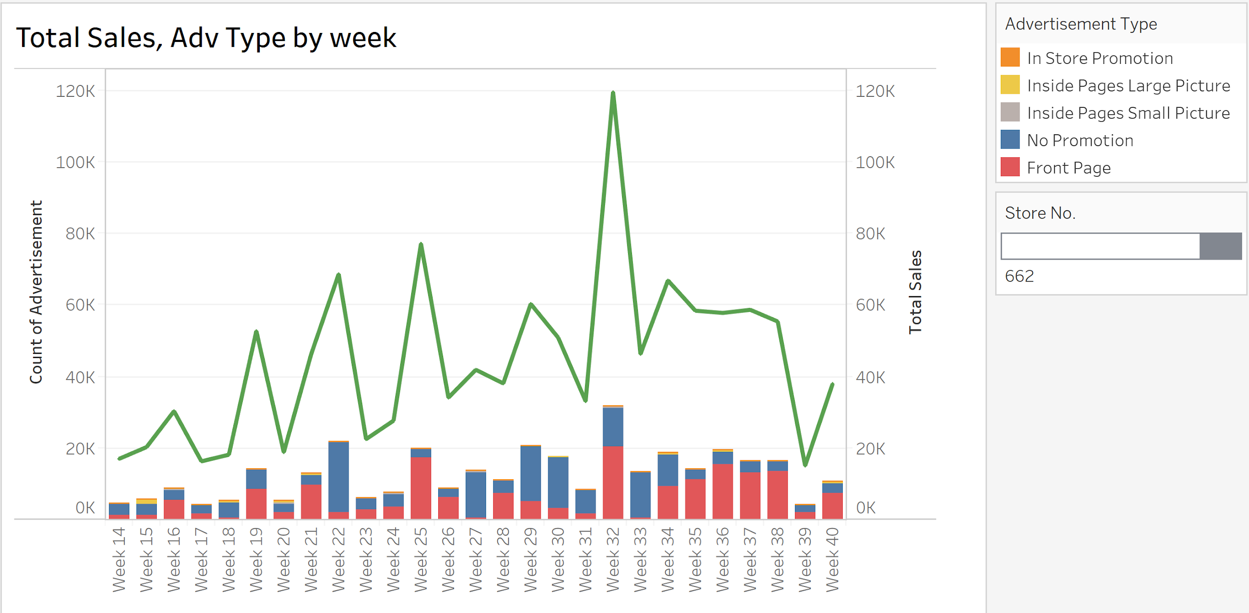
Cereal Sales and Ad sizes for Store 662

Slide 10
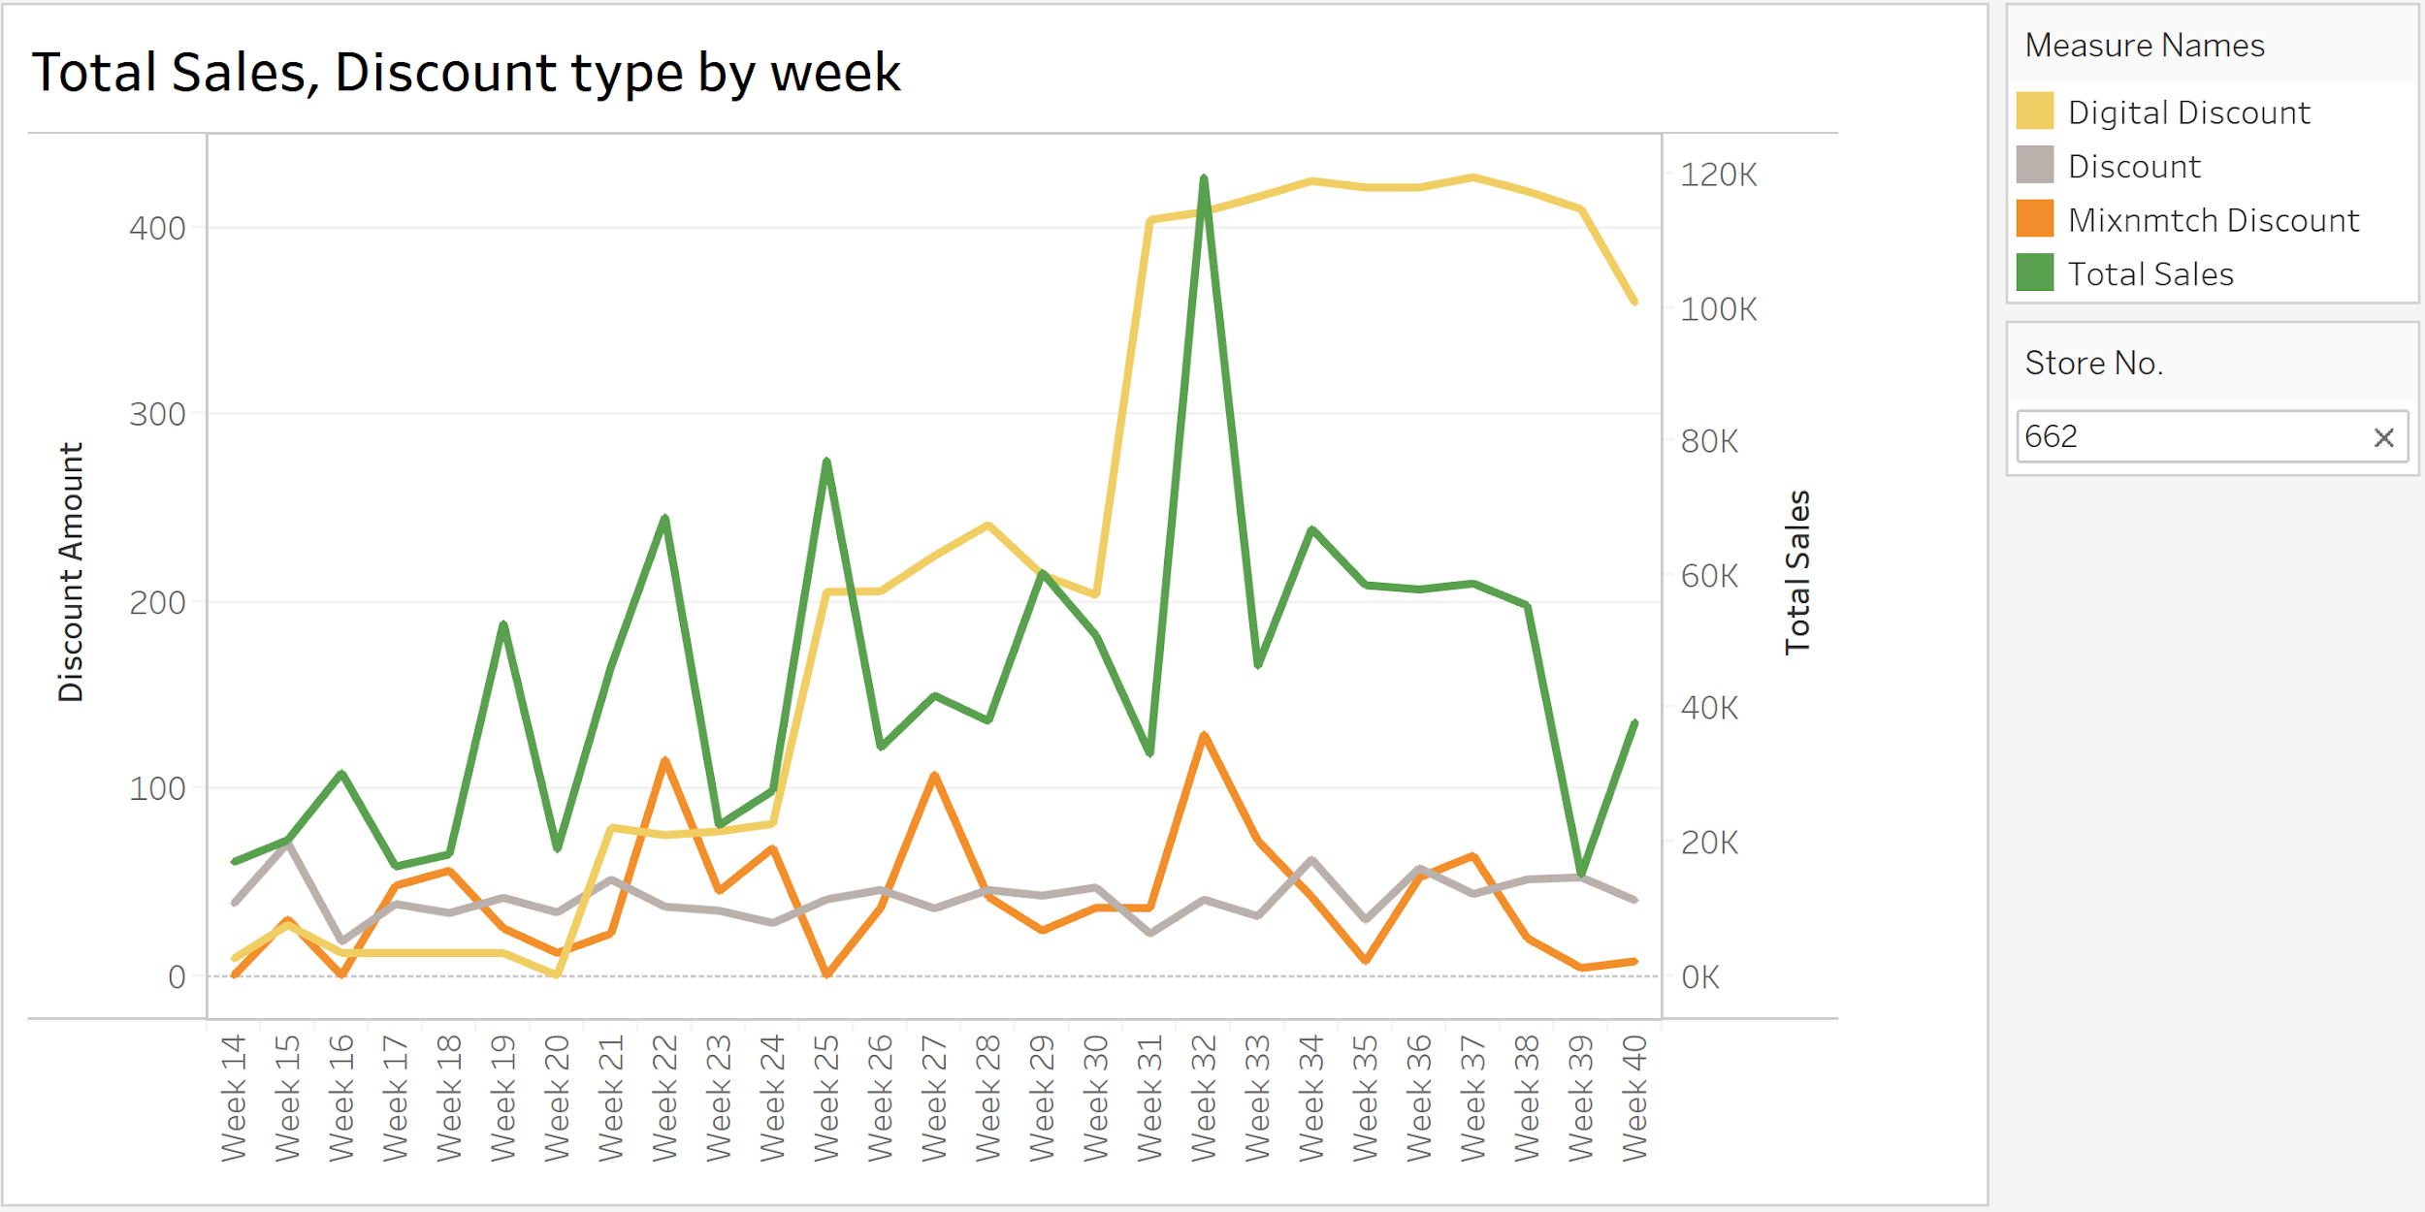
Cereal Sales and Discount Types for Store 662

Slide 11
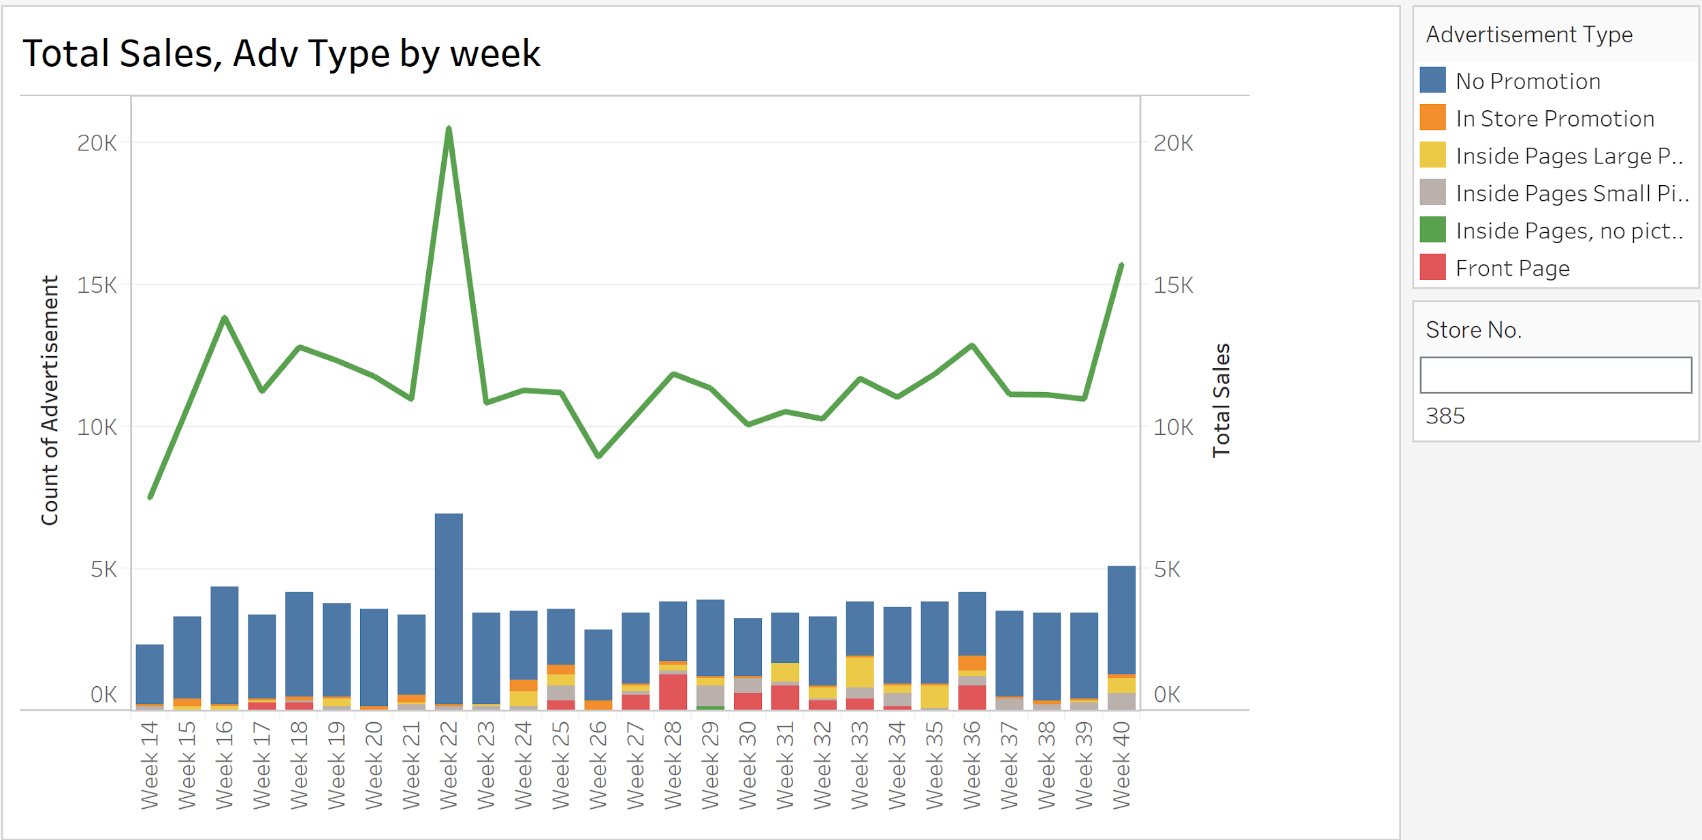
Wholesome Pantry Sales and Ad Sizes for Store 385

Slide 12
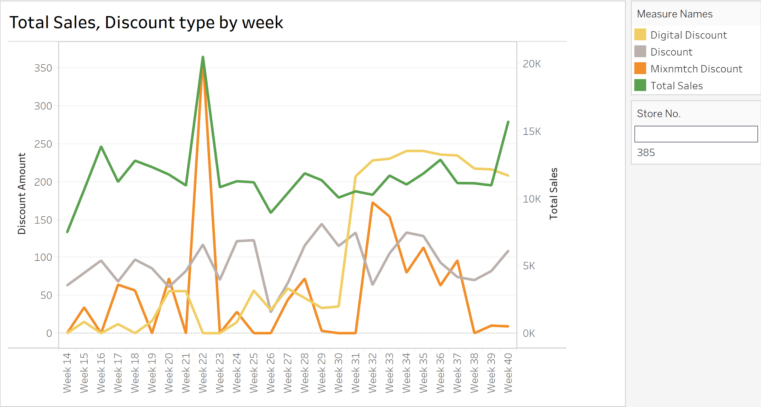
Wholesome Pantry Sales and discount types for Store 385

Slide 13
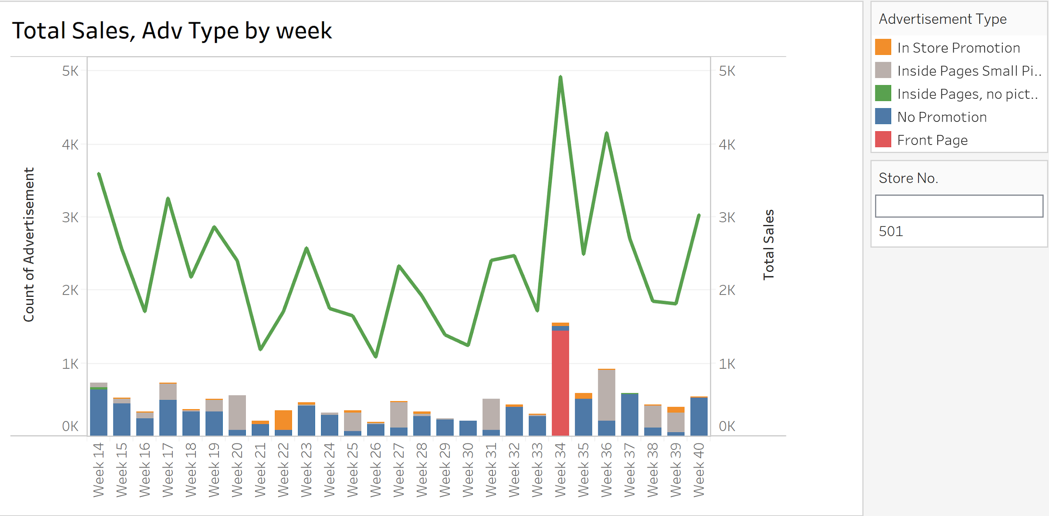
Frozen Poultry Sales and advertisement trend for Store 501

Slide 14
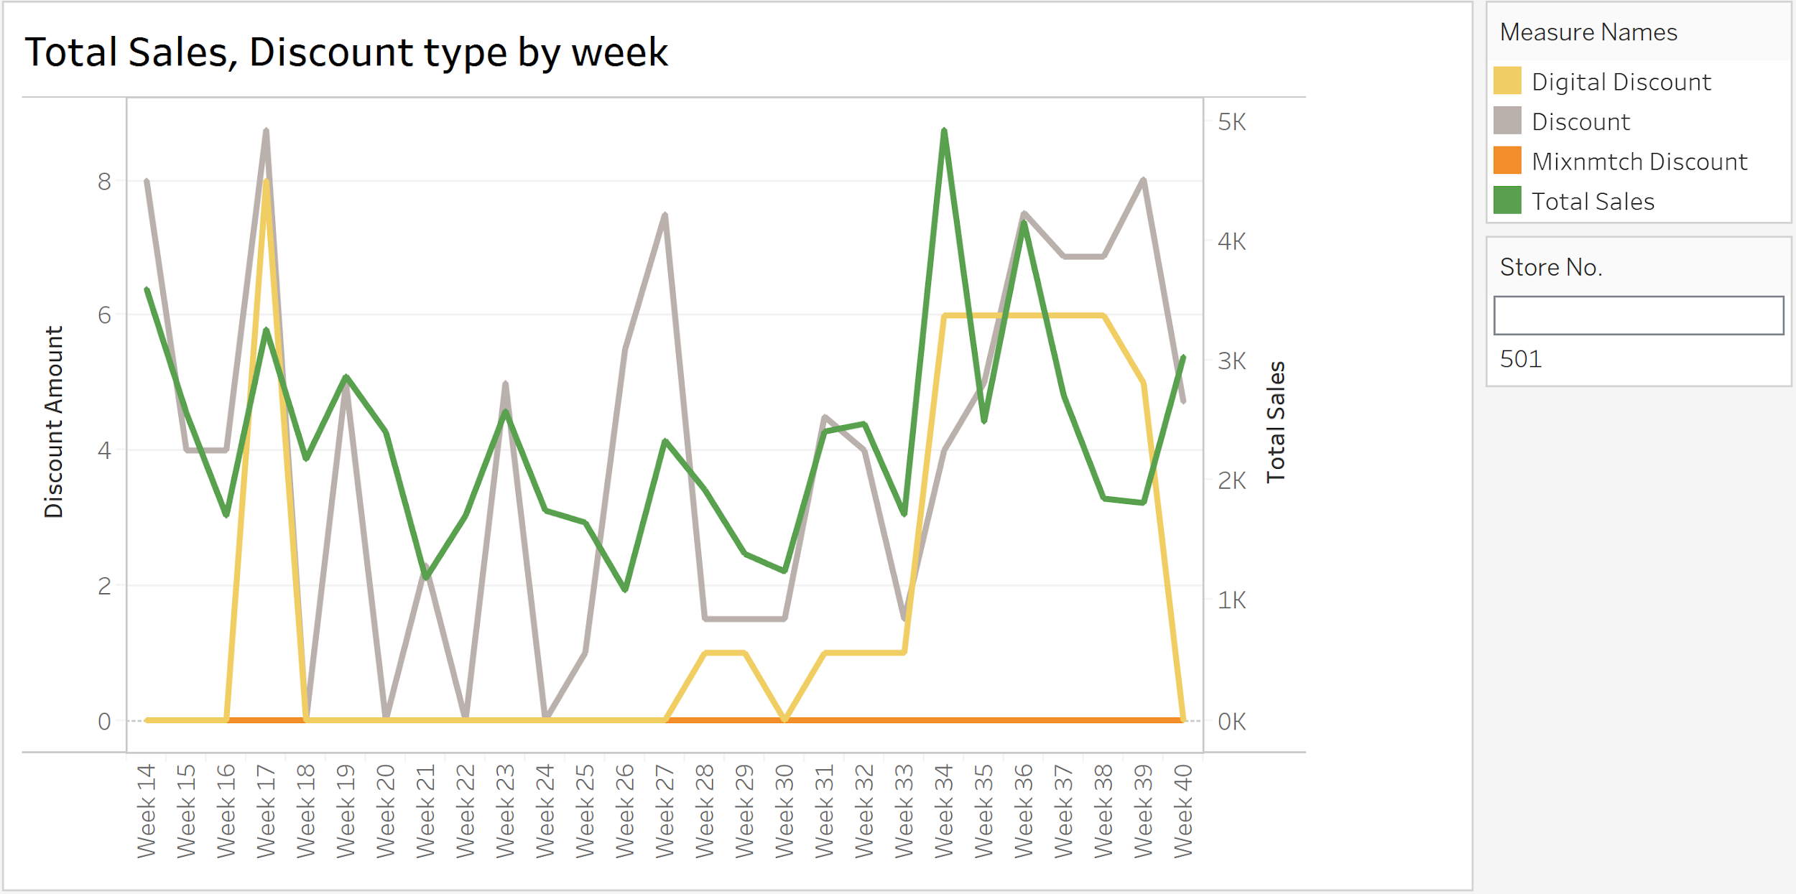
Frozen Poultry Sales and discount trend for Store 385

Slide 15
Multiple Regression Model
To analyze which variables are contributing towards sales in each category and their significance, we decided to run a multiple regression model using Dollar Salles (TTL_SCAN_DLR_AMT) as our target variable.
We use the different discount types variables(DSCNT_AMT, DIGTL_DSCNT_AMT, MIXNMTCH_DSCNT_AMT) and Ad size variables (NOT_PROMOTED,IN_STORE, FRONT_PAGE etc.) as our independent variables.
We also decided to use stepwise feature selection in our model to filter out insignificant variables. Using marketing analytics general practice, we set a 10% significance criteria for the attributes.

Slide 16
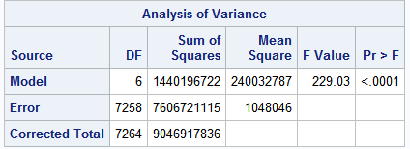
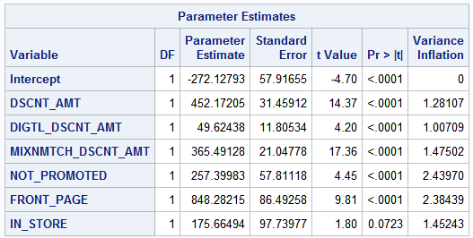
Regression Models
After running the models, we get the following equations for the 3 stores in their respective categories.
Cereals - Store 662
  Sales = -272.12 + 452.17* (DSCNT_AMT) + 49.62*(DIGTL_DSCNT) + 365.49*(MIXNMTCH) + 257.39*(NOT_PROMOTED) + 848.28*(FRONT_PAGE) + 175.66*(IN_STORE)
Wholesome Pantry - Store 385
  Sales = 37.56 + (DSCNT_AMT)*14.15 + (DIGTL_DSCNT)*4.22 + (MIXNMTCH)*20.3 - 7.36*(NOT_PROMOTED) - 16.76*(IN_PAGE_LARGE_PHOTO)
Poultry - Store 501
  Sales = 27.43 + 15.06*(DSCNT_AMT) + 23.34*(NOT_PROMOTED) + 503.29*(FRONT_PAGE) + 66.99*(IN_PAGE_SMALL_PHOTO)

Slide 17
Analysis & Interpretation
Let us consider the equation of store 662, the highest seller in the cereal category.
  Sales = -272.12 + 452.17* (DSCNT_AMT) + 49.62*(DIGTL_DSCNT) + 365.49*(MIXNMTCH) + 257.39*(NOT_PROMOTED) + 848.28*(FRONT_PAGE) + 175.66*(IN_STORE)
We first establish a baseline for a Non promoted item. If a cereal item is not promoted then the baseline is -272.12 + 257.39*(1) = -14.73, implying this will lead to a reduction in sales by that amount over the time period.
This model tell us that the most effective ad size in driving sales was a front page promotion. Which means that if a cereal item was featured on the front page, it effectively drove an increase in sales by -272.12 + 848.28*(1) = 576.16, over that time period.
We also see that the least effective discount type was a digital discount coupon. However this could also be due to the fact that not many customers used digital coupons.

Slide 18
Similar Insights
We can glean similar insights by looking at the models of store 385 and store 501, the highest sellers in the wholesome pantry and poultry category respectively.
Wholesome Pantry - Store 385:
  Sales = 37.56 + (DSCNT_AMT)*14.15 + (DIGTL_DSCNT)*4.22 + (MIXNMTCH)*20.3 - 7.36*(NOT_PROMOTED) - 16.76*(IN_PAGE_LARGE_PHOTO)
  This implies that for this store number, a non_promoted item used with a mix n match coupon was most effective in driving sales of wholesome pantry products
Poultry - Store 501:
  Sales = 27.43 + 15.06*(DSCNT_AMT) + 23.34*(NOT_PROMOTED) + 503.29*(FRONT_PAGE) + 66.99*(IN_PAGE_SMALL_PHOTO)
  Again, this potentially implies, that a front page promotion combined with a traditional discount coupon was most effective in driving sales.

Slide 19
Recommendations
Since the stores we used were top sellers within their respective product category, stores with lower sales in those categories could potentially try to replicate the strategies of those specific stores.
For Cereals:
  Discount Rank:
    Traditional Discount Coupon
    Mix N Match Coupon
    Digital Discount Coupon
  Ad Type Rank
    Front Page Promotion
    No Promotion
    In Store Promotion
For Wholesome Pantry:
  Discount Rank:
    Mix N Match Coupon
    Traditional Discount Coupon
    Digital Discount Coupon
  Ad Type Rank
    No Promotion
    In Page large photo
For Poultry:
  Discount Rank:
    Traditional Discount Coupon
  Ad Type Rank
    Front Page Promotion
    In Page small photo
    No promotion

Slide 20
Conclusion
Some ad types or discount types may not be present in the final equation, this could be because the model determined they are not significant enough to be in the model, or it could also be because that item category did not have those ad types or discount types running.
Since it is a regression model, it can be applied onto many other subset variations of the data to extrapolate and examine the results. For example, the model could be applied to all sales of item_num=######## or even sales of top 25 items within a given category.
There are multiple opportunities for further analysis in the future.

Slide 21
THANK YOU.

